Slide 1




DEMAND AND SALES
IMPROVEMENT ANALYTICS

Slide 2










TABLE OF CONTENTS
BUSINESS PROBLEMS
DATA UNDERSTANDING
DATA UNDERSTANDING – CRITICAL AREAS
DATA TRANSFORMATION
DATA ARCHITECTURE
SOLUTIONS – Sample Case: Demand & Sales in Critical Areas(2003-05)
ROADMAP
NEXT STEPS

Slide 3

















BUSINESS PROBLEMS
OVERVIEW (2003-05)
KPIs
1.12 million products and 3,932 quantities of 2 categories are ordered.
No. Of Orders
Sales By Country
Quantity Ordered By Product Category
Quantity Ordered By Region
USA and Spain are the leading countries in demand and sales generation
throughout the period.
Total sales during the span of 2 years is $380K where motorcycles have contributed heavily towards sales generation as compared to classic cars.
PROBLEMS
DEMAND
Overall demands has been varying in all the countries with respect to time, while Spain beating USA in generating maximum demand in the year 2004-05.
An observation on changing demand parameters in Spain will give a better insight.
Insights on changing demand patterns will help in ensuring quality services.
Understanding the principal cause behind decreasing sales in majority of the countries.
Understanding the principal cause behind decrease in demands in majority of the countries.
Key solutions to find out the ways to increase demands and sales in the target countries.
SALES
Increasing annual sales by 15-20% (approx.) for classic cars.
Increasing annual sales by 14-20% (approx.) with respect to regions.
Insights on changing demand patterns will help in ensuring quality services.
This slide is designed as per the dataset given for the analysis. The content may vary for other datasets.

Slide 4












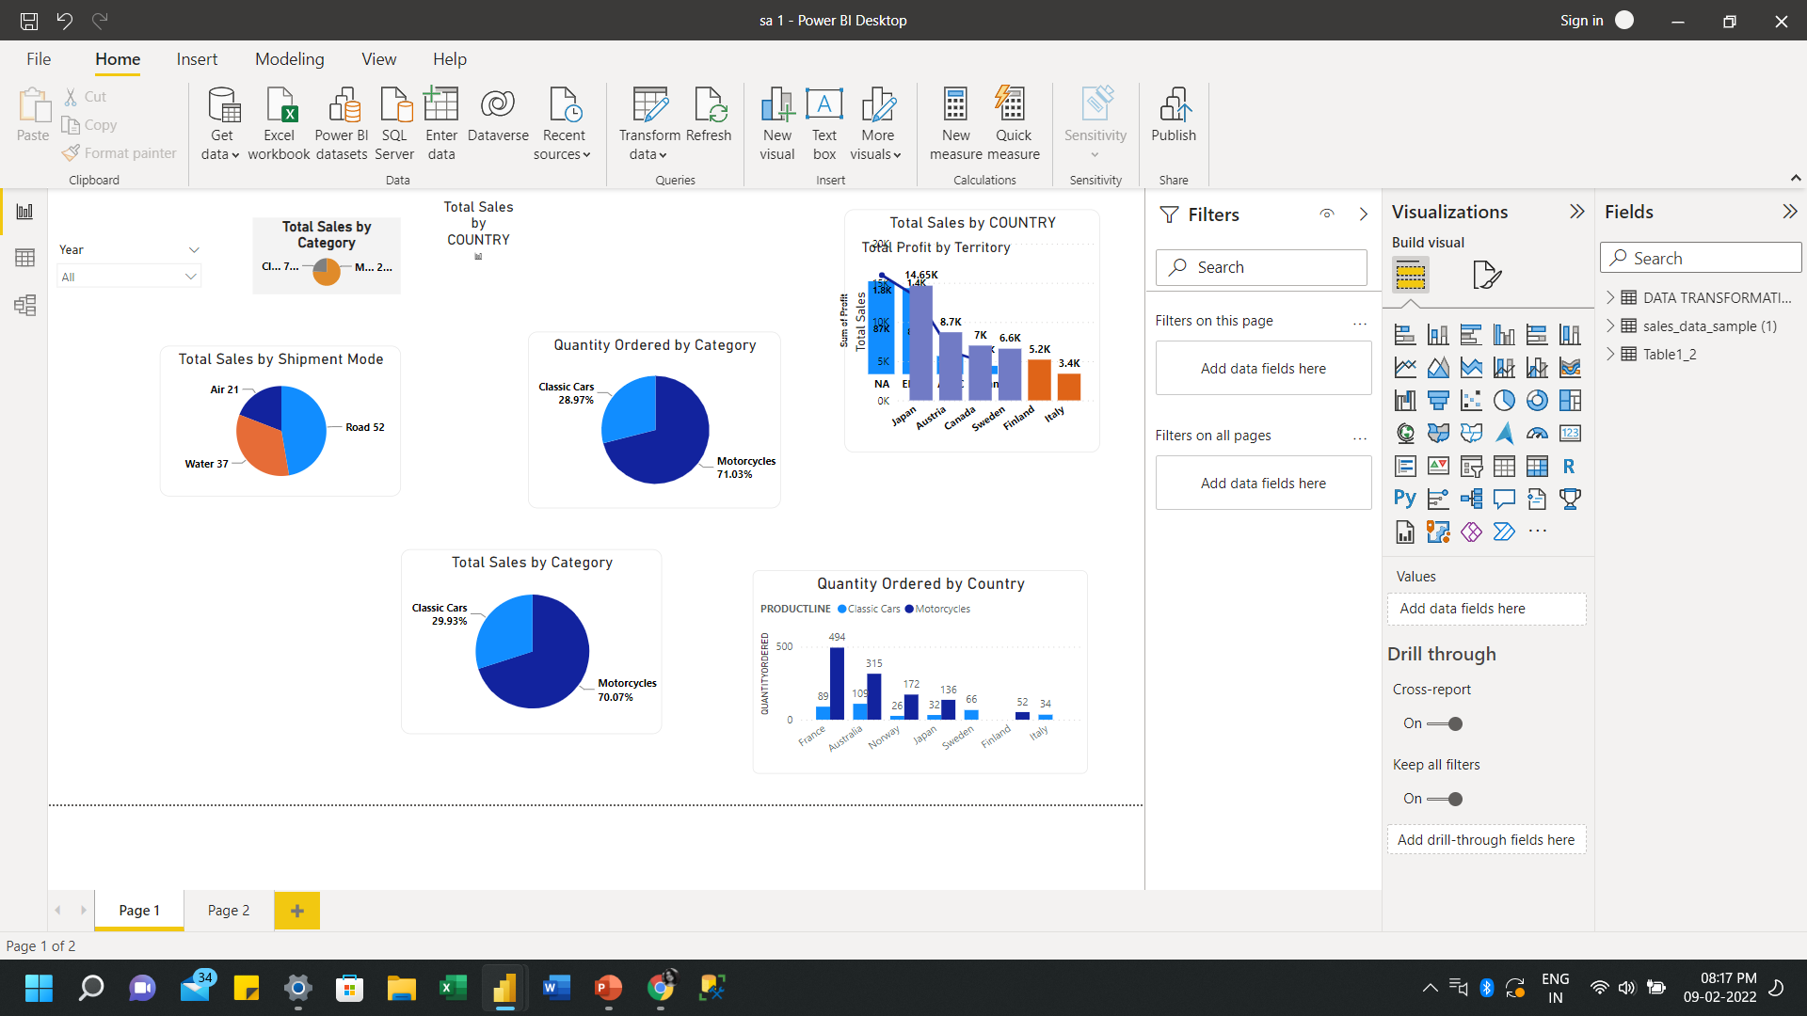
DATA UNDERSTANDING
Time Span
No. of Orders
Quantities Ordered
Product Category
Mode of Shipping
Countries
Booking Channel
Total Production Cost
Total Sales
2 Years
(2003-05)
1.12M Orders
3932 Quantities
2 Categories
Road
Air
Water
14
Countries
4 types
$188.9K
$380K
Web
Email
Walk-in
Phone
OVERVIEW
In a span of 2 years, 1.12 million products and 3,932
quantities of 2 categories are ordered.
The orders received are from 14 countries and 42 cities.
Customers used 4 channels to book the tickets.
3 types of mode of shipping are used to deliver the products.
The total production cost of these products is $188K.
The total sales generated is $380K.
This slide is designed as per the dataset given for the analysis. The content may vary for other datasets.

Slide 5

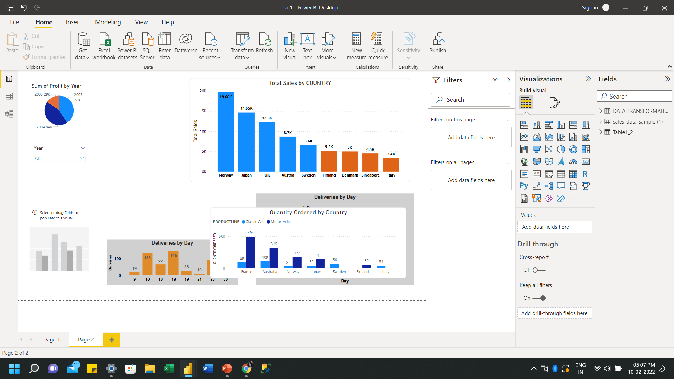



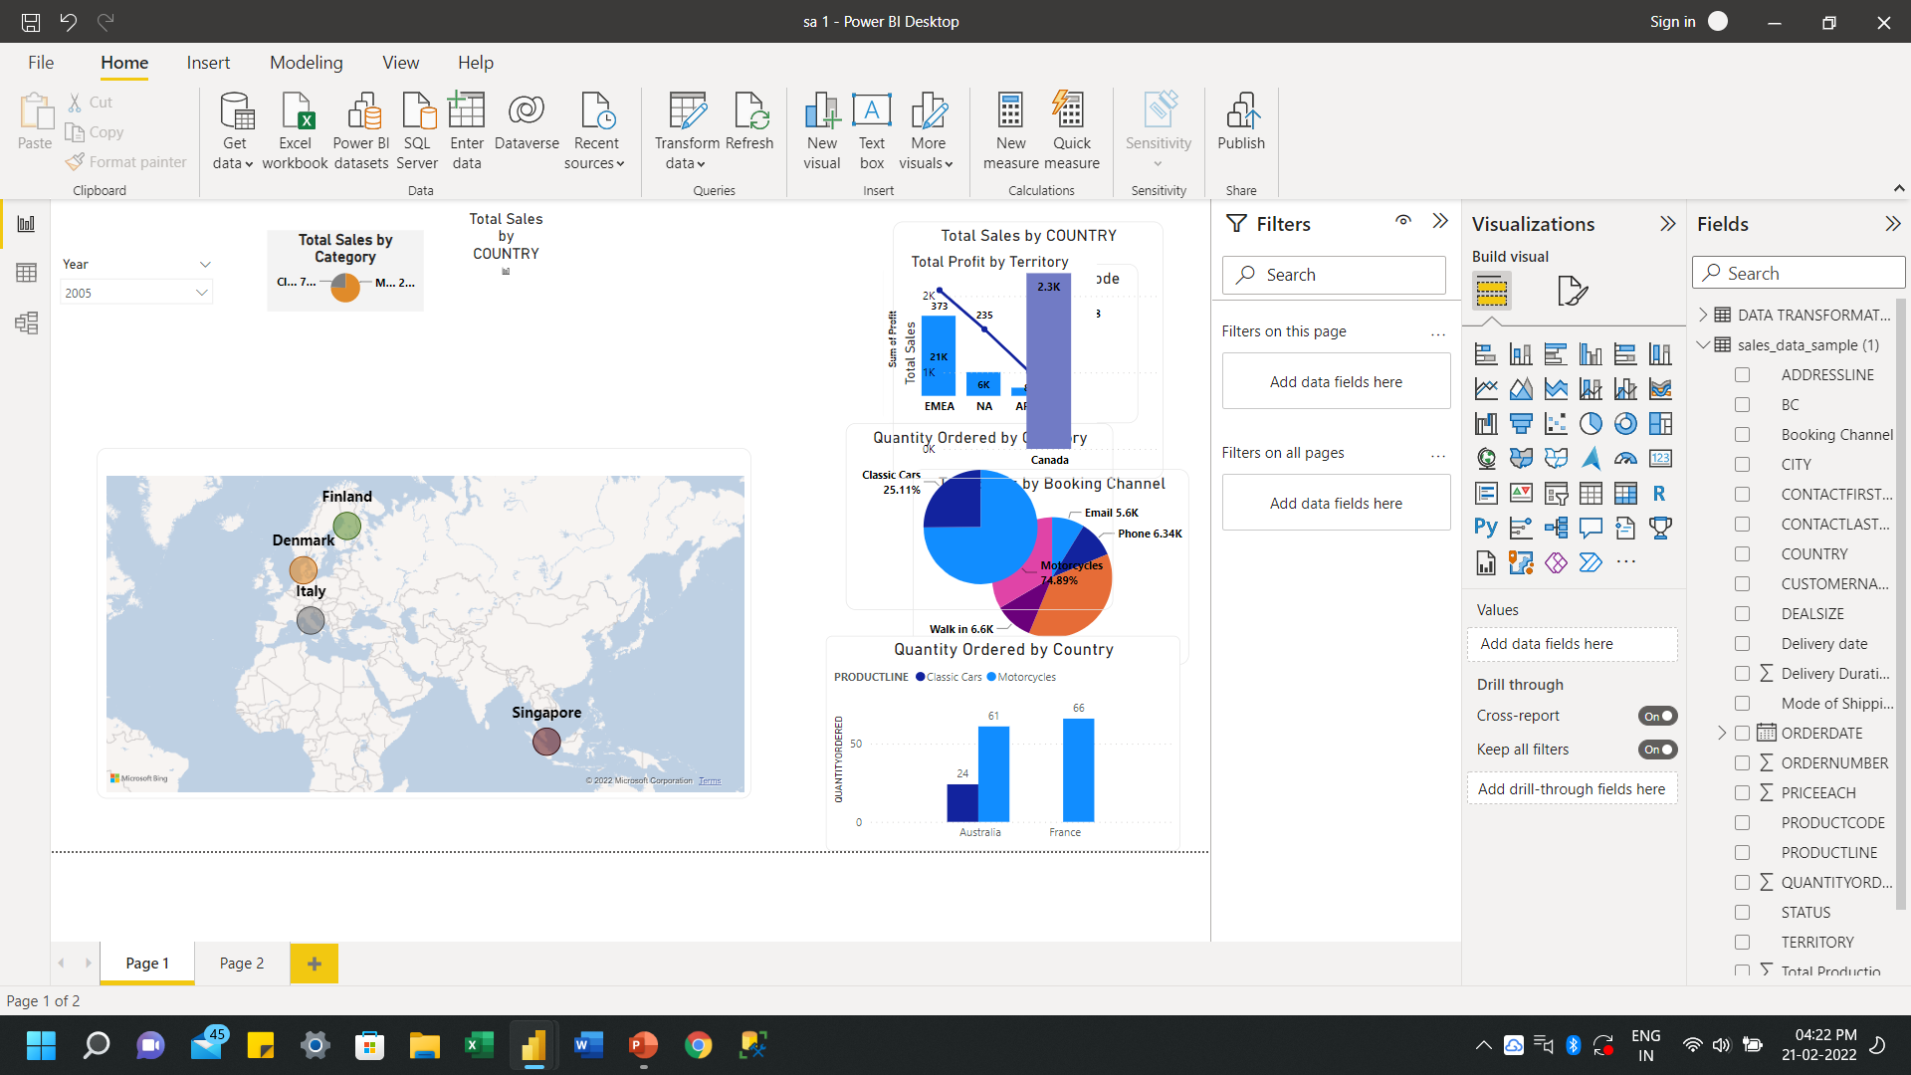
DATA UNDERSTANDING – CRITICAL AREAS
Critical Areas
(Those areas where sales is<6K)
The mentioned critical areas have generated their own sales, which are not up to the critical benchmark and thus require some insights to cross the critical point.
Among these 4 areas, an approximate increase of 78% in sales in Italy, 50% in Singapore, 25% in Denmark and Finland each will bring the sales above the critical benchmark.
In these areas, annual sales sums up to a sum of $380.5K. An approximate increase of 18% will bring it up to $449.07K.
Here the graph represents 14 areas with different values of sales generated in 2003-05, where 4 out of 14 areas are critical areas(as per the assumption).
These 4 areas are below the critical benchmark and thus require more attention and thorough analysis for increasing sales and therefore, profit.
Critical Benchmark
Critical Areas
Critical Areas
This slide is designed as per the dataset given for the analysis. The content may vary for other datasets.
Notes:
You can safely remove this slide. This slide design was provided by SlideModel.com – You can download more templates, shapes and elements for PowerPoint from http://slidemodel.com

Slide 6






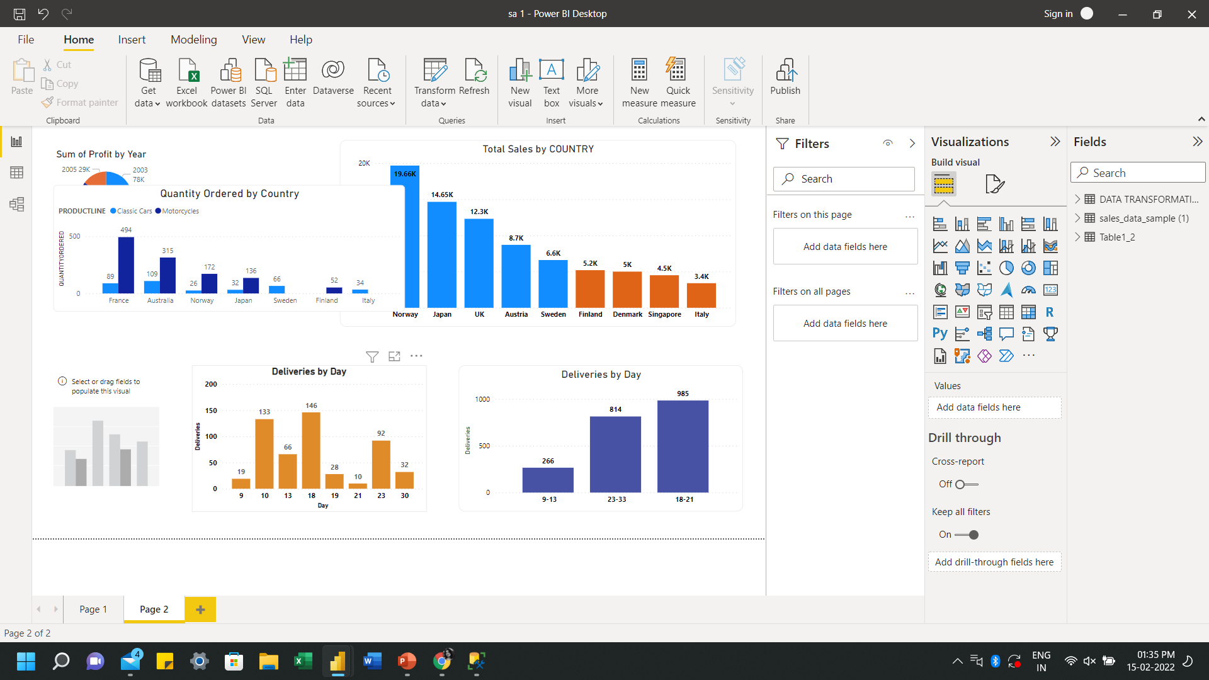

DATA TRANSFORMATION
Loaded the data and transformed the data for analysis
Run a check for null values and replaced those values with ‘0’ as instructed
Grouped delivery days for better clarity on delivery services in the format: (9-13), (18-21), (23-33)
Created hierarchies in the time period in the format: year, quarter, month, days
Created custom columns for calculation of further parameters
Here, the delivery days for orders are mentioned for the year 2003-04. The deliveries are shown with respect to days time the product takes to deliver.
TRANSFORMATION
Here, the delivery days have been categorized to check the delivery services.
(9-13) days–Good
(23-33) days–Poor
(18-21) days–Average
This slide is designed as per the dataset given for the analysis. The content may vary for other datasets.

Slide 7
































DATA ARCHITECTURE
Data Sources &
Data Preparation
Data Exploration
Data Flow
(ETL)
Data Analysis & Solution Building
Solution Validation
Final Deliverables
Import
Data
Implement Solutions
RDBMS
DATA
Find
Problem
Dissect Problem
Generate Solutions
Solutions
Report
Product Details
Analyse Data
Connect Hypothesis & Solutions
Conclusions
Dashboard
CLOUD
Find Problem’s Scope
Analyse dissected Portions
Validate Solutions
Region
Validate data
Insights
Analysis
WEB
Define Problem
Monitor and validate the results
Orders
Data
Refining
Create hypothesis
Find
Insights
Data Preparation
DATABASE
Claims Supporting Problem
Draw Conclusion from implemented methods
Data Transforming
Customer Details
Validate Hypothesis
Visualize Insights
Data Visualization
Spreadsheets
Data Aggregating & Loading
This slide is designed as per the dataset given for the analysis. The content may vary for other datasets.

Slide 8
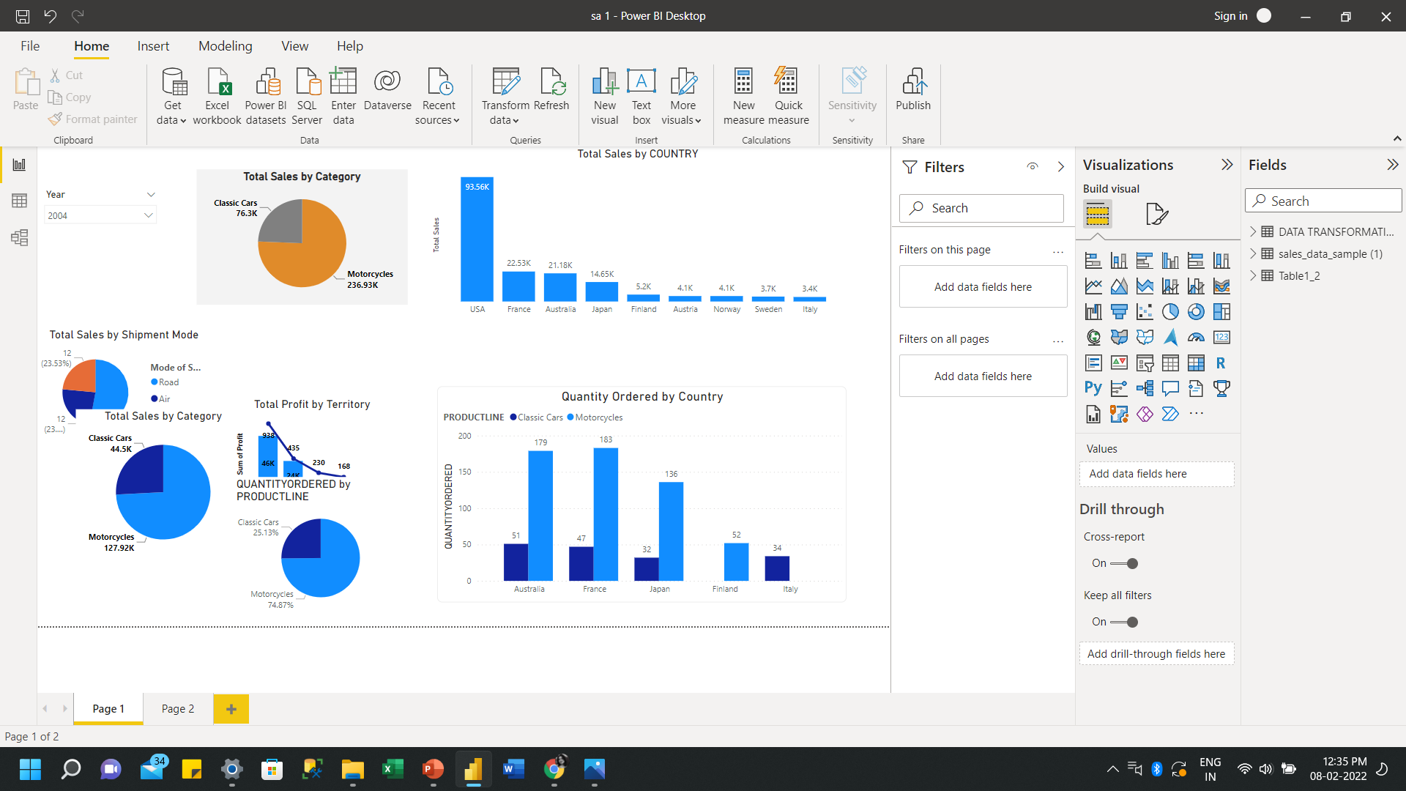
SOLUTIONS – Sample Case: Demand & Sales in Critical Areas(2003-05)
The critical benchmark for Classic Cars is >20 and for Motor Cycles is >100.
Italy and Finland are the critical areas.
Here, the graph represents quantity ordered in the different regions w.r.t critical areas during the span of 2 years.
The quantity ordered in non-critical areas for both the categories has crossed the critical benchmark and thus have contributed heavily in demand generation.
Finland and Italy has ordered the least Classic Cars & Motorcycles, respectively.
Therefore, a potential increase in demand for Classic Cars in Finland and Motorcycles in Italy would help the areas to cross the critical mark, and contribute towards demand generation.
Motorcycles
Classic Cars
100
20
The critical benchmark for the span of 2 years for Sales per region is >6K.
Here, the graph represents sales generated from various regions during the span of 2 years.
Italy, Singapore, Denmark and Finland have experienced decline is sales and have contributed less to sales generation.
Therefore, an approximate increase of 78% in sales in Italy, 50% in Singapore, 25% in Denmark and Finland each will bring the sales above the critical mark.
Overall, annual sales sums up to $340.5K. An approximate increase of 18% will bring it up to $401.4K.
Critical Benchmark
This is a sample case study for demand and sales in critical areas. Further breakdown would be shown in retail analytics.

Slide 9




ROADMAP
IMPLEMENTATION
DESIGN & DEVELOPMENT
TESTING & VALIDATION
DEPLOYMENT
DISCOVERY PROCESS
Gathering data from database sources such as RDBMS, cloud, web, spreadsheets, etc.
Importing, analysing and visualizing the data.
Extracting, transforming and loading the data in Excel or power query.
Using refined data to create data models by using Excel.
Creating models to visualize and manipulate data using graphs, charts, etc.
Generating data visualization dashboards and reports using Power BI.
Designing methods to achieve objectives.
Processing the designed methods
Implementing the strategic plans to meet project requirements.
Analysing methods implemented in the process.
Checking for possible errors and validating the accuracy of implemented methods.
Launching the deliverables.
Preparing to go-live to ensure smooth transition of implemented methods.
Maintaining the project reports by setting data refresh frequency of 12 hrs.
2 weeks
2 weeks
2 weeks
2 weeks
2 weeks
This slide is designed as per the dataset given for the analysis. The content may vary for other datasets.

Slide 10




NEXT STEPS
1
2
3
4
5
COLLECTING UPDATED DATA TO REFRESH MODELS
RUNNING QUALITY CHECK ON SHIPPING & DELIVERY SERVICES
TARGETING LOW CRITICAL
AREAS
CHECKING CUSTOMER BEHAVIOUR W.R.T ORDERS
ENHANCING BOOKING SERVICES AND CUSTOMER SUPPORT SERVICES
Refreshing and collecting updated data to develop more accurate models.
Creating updated data models to gain more insights on changing patterns in parameters like customer behaviour, sales, etc.
Checking service quality of the delivery services by delivery days and orders delivered.
Getting insights on orders delivered via various shipping modes with respect to regions to enhance shipping services.
After resolving high critical area’s problems, the target is to check for parameters in low critical areas which have impacted overall business.
Targeting low critical areas to design strategies to improve demand and sales in those areas.
Customers from USA and SPAIN have placed the highest orders whereas customers from ITALY and FINLAND have placed the least orders.
Insights on changing patterns will improve services in regions with least orders..
More customers have opted for walk-in and web channels to purchase the product and insights on use of other booking channels will enhance booking services.
Implementing strategies to assist the customers via query calls, chatbots, query messages, etc.
This slide is designed as per the dataset given for the analysis. The content may vary for other datasets.

Slide 11
THANK YOU!

